Slide 1
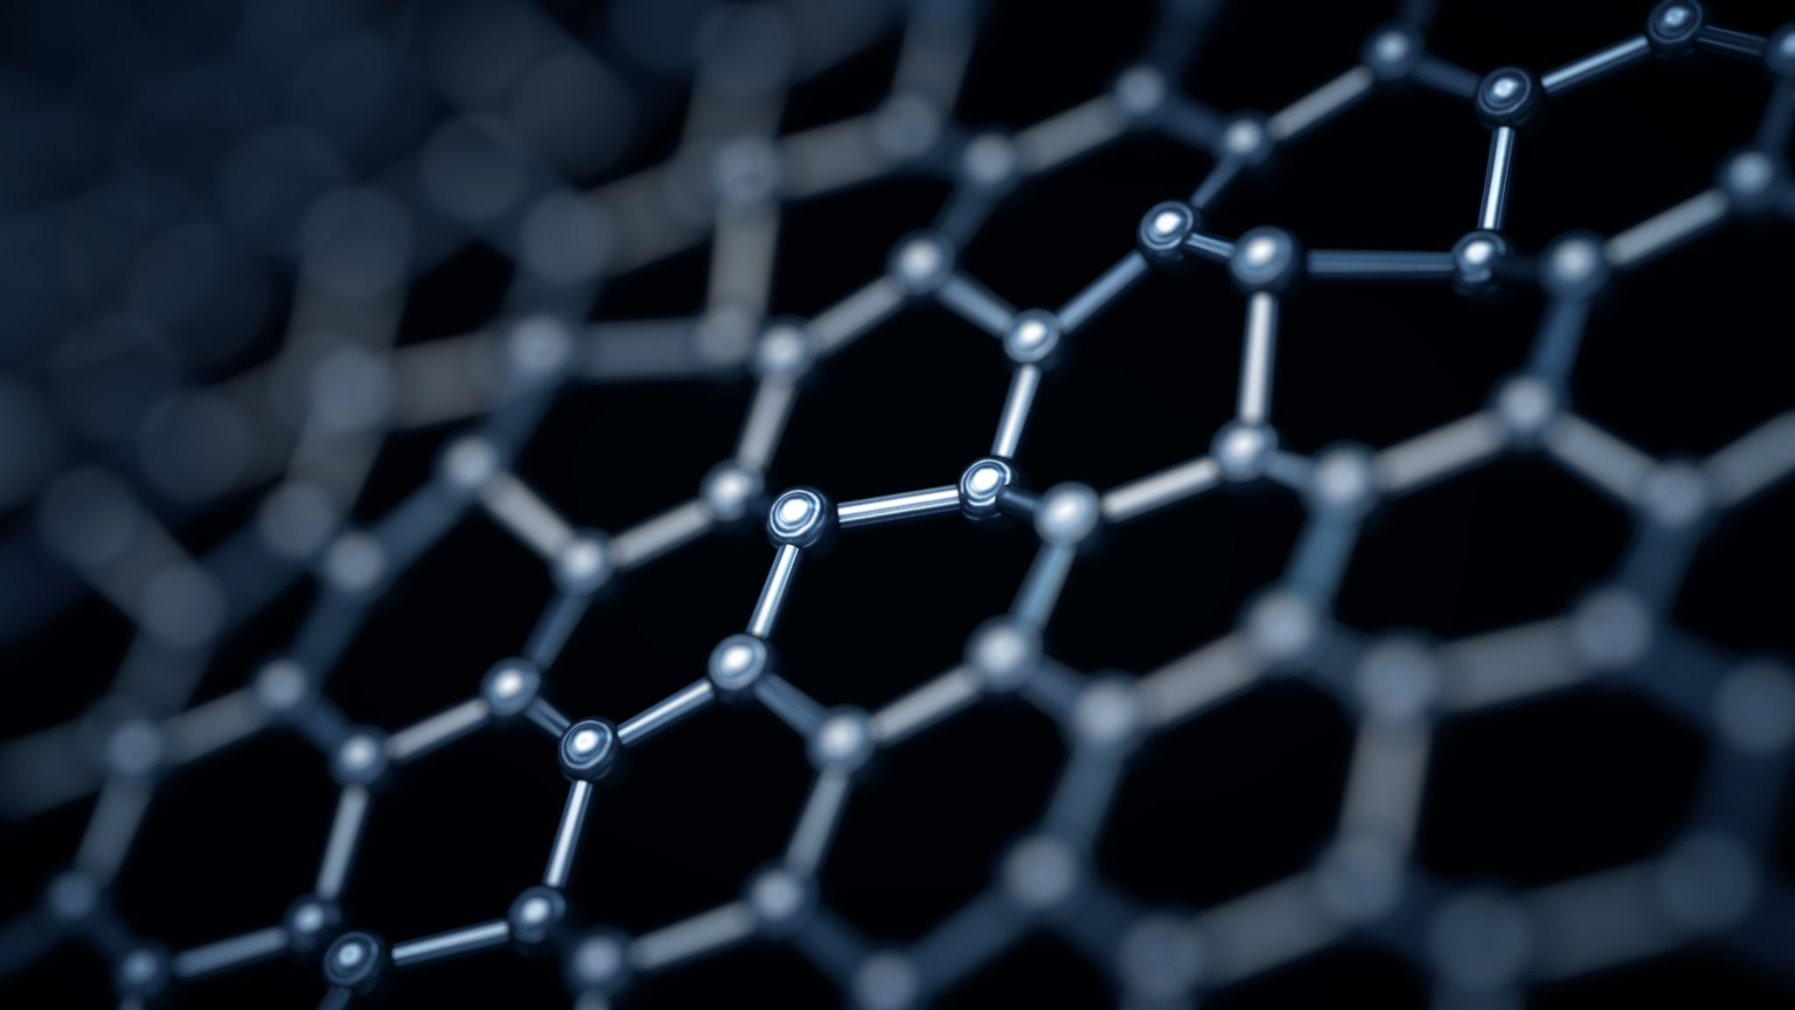
Bioimpedance - how does soft matter respond to electrical fields?
Marcin Tomkiewicz

Slide 2
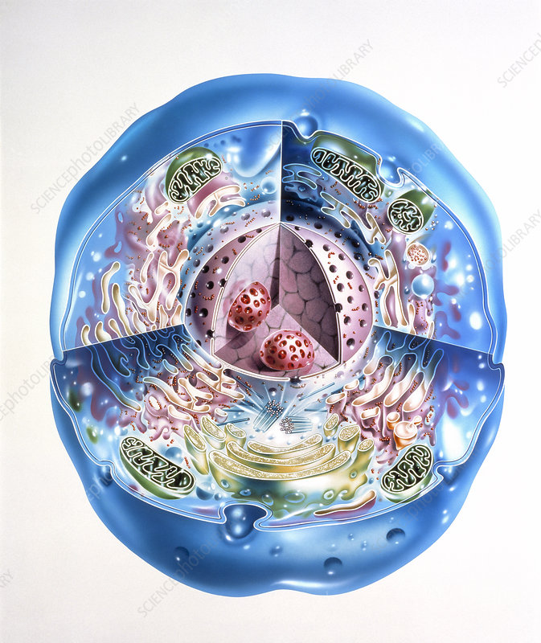
Water and other basic compounds that make up our bodies

Slide 3
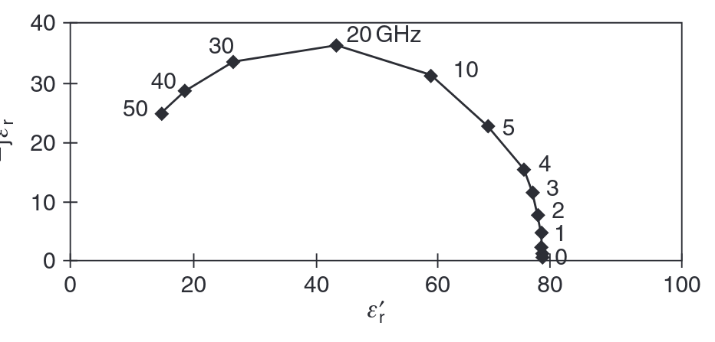
Water
Water is a polar liquid, that makes up around 70% of our bodies
Water has high relative permittivity of about 73 at 37°C, but addition of electrolytes it proportionally to concentration
Because of strong dipolar electric field water molecules are attracted to ions and local charges, forming a hydrated layer
Fig. 1 Complex relative permittivity of pure water at 25°C
Notes:
water is a polar liquid with a static relative per- mittivity of about 80 (20°C), falling to 73 at 37°C (Fig. 4.1). The addition of electrolytes such as NaCl or KCl lowers the permittivity pro- portionally to concentration (e.g. with a dielectric decrement /span>/span>r of about 4 for 250 mmol/L concentration of KCl (cf. Section 3.3)). The high permittivity is one reason for the dissociative power of water. Ionic bonds are split up so that ions exist in aqueous solutions in a free, but hydrated form. Because of the strong dipolar electric fi eld, water molecules are attracted to ions and local charges, forming a hydrated layer (sheet) which tends to neutralize the charge and increase the effective dimensions of the charged particle.

Slide 4
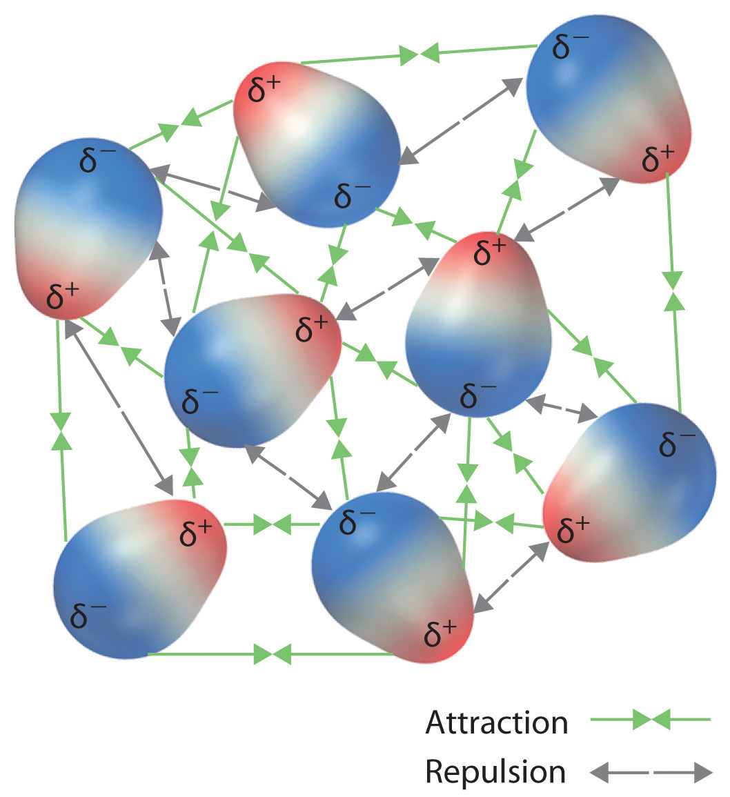
Living organism's water
Even though water inside our body is the same H2O, thanks to complex structure of living organisms its electrical properties are different than that of a water in a glass
Water in human body can be bound to charged ions like proteins so srtongly, that it must be considered more like a solid than as a liquid
Living cells mus contain and be surrounded by aqueous electrolytes
Fig. 2 Water and its dipole attraction/repulsion
Notes:
he living cell must contain and be surrounded by aqueous electrolytes. In human blood the most important cations are: H /span>, Na /span>, K /span>, Ca /span>/span>, Mg /span>/span>; and anions: HCO3 /span>, Cl/span>, protein/span>, HPO4 /span>, SO4 /span>. Note that protein in the blood is considered as a negative (macro)-ion.

Slide 5
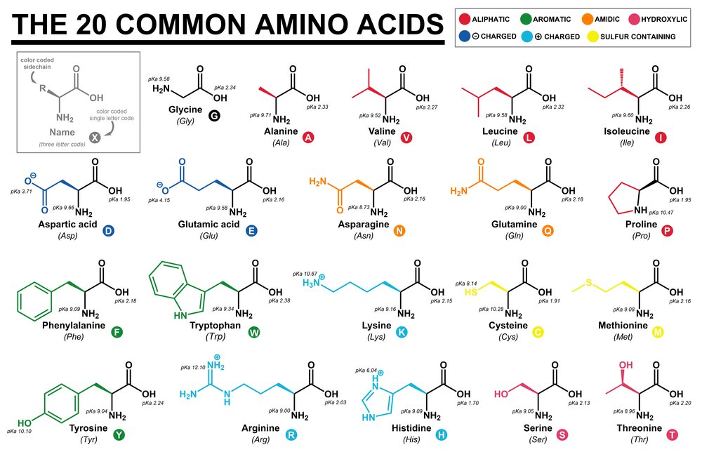
Amino acids
Amino acids are the 20 monomers of proteins, which are the most abundant macromolecules in human body
All amino acids share the same group (Fig 4.) representing a permanent dipole moment with zero net charge
These 20 amino acids are separated into: - 8 hydrophobic - 7 hydrophilic - 5 charged (2 negatively, 3 positively)
Fig. 4 The 20 common amino acids
Notes:
This common group is shown in ionized form as would occur at pH 7, the amino group has acquired a proton (NH 3 /span>), and the carboxyl group has lost one (COO /span>). The charges are separated and represent a permanent dipole with zero net char and such substances are polar. At pH 7 all amino acids are more or less polar . Even so, the common group is also paradoxically called a “dipolar ion” or a zwitterion, because at other pH values it attains a net charge: at low pH values, the NH 3 /span> group dominates and the acid is a cation with a net positive charge. At high pH values, the COO /span> group dominates and the “acid” is an anion with a net negative charge. Clearly, the term amino acid may be misleading, because in water solution they actu- ally can be an acid (proton donor) or a base (proton acceptor). Even if these condi- tions mostly are non-physiological, the acid–base behavior in vitro is valuable for the examination and mapping of amino acids The R symbolizes a side chain that determines the properties of each amino acid. The electrical properties of the protein are also strongly dependent on this R-group, but only if it is polar or charged. The amino acids are classified according to their R-groups, but the properties of an R-group and therefore the amino acid are very dependent on pH and molecule confi guration, so the classification differs in the lit- erature. The following classification for the 20 amino acids may be used at a physi- ological pH around 7.4: Eight of the amino acids are hydrophobic and therefore the R-groups are grouped as non-polar: they are without net electric charge and have a negligible dipole moment. The net dipole moment of all eight amino acids is equal to that of the common group. Seven are hydrophilic and the R-groups are therefore grouped as polar. These polar R-groups have an expected large infl uence on dielectric permittivity. Some of them tend to dissociate H/span> ions so that the amino acid also becomes charged and ionic. Two are with negatively charged R-groups and therefore have a net negative charge. Three are with positively charged R-groups and therefore have a net positive charge.

Slide 6
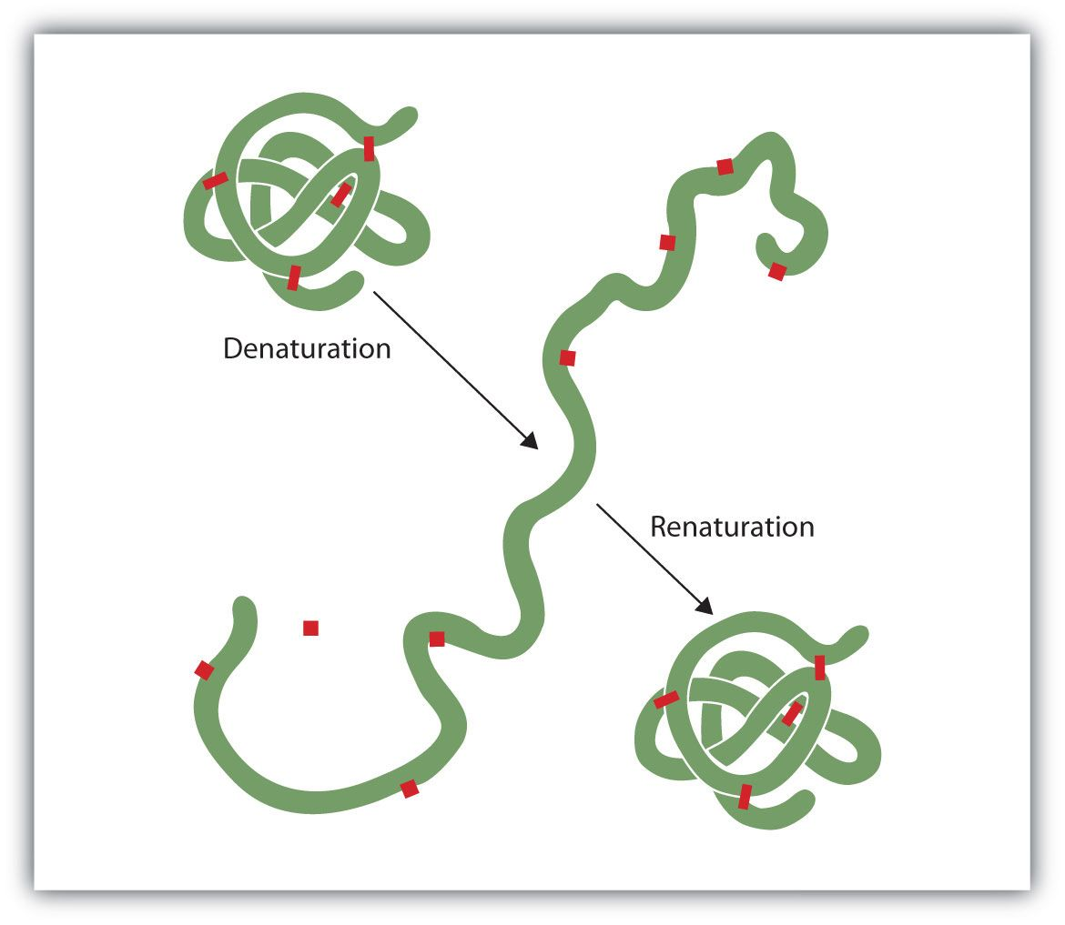
Proteins
Protein can take a very complex forms, using hydrogen or Van Der Vaals bonds or a chaotic morphology by denaturation.
Distances between charges in proteins can be very high, and therefore dipole moment can be very high
Protein with high number of ionized groups can migrate or polarize in electrical field
Fig. 5 Denaturation and renaturation of protein
Notes:
A protein may have a very regular form like an /span>-helix, or a chaotic morphol- ogy by denaturation at high temperatures or extreme pH values. The denaturation of a protein reduces the solubility in water, and heat coagulation of tissue is there- fore accompanied by water liberation. The denatured protein nearly always looses its characteristic biological activities, and the electric properties are often completely changed. This shows the importance of the higher orders of the geometrical (second- ary) structure of a protein.
s the forms become more complex, very different forms of charge distributions and bonds are possible. The rigidity of the bonds will be important for the electrical relaxation phenomena. In comparison with the displacement of electrons and nuclei during atomic polarization (10 /span>15 m), the distance between the charges in a macro- molecule can be very large (10 /span>8 m). Therefore the dipole moment of proteins could be very large. But the symmetry of the electric charges in protein molecules is also surprisingly high.
A protein with a large number of ionized groups is a polyelectrolyte if it has a net electric charge. If it is free, it will migrate in an electric fi eld. Usually it is not free, and may therefore only undergo local polarization. Because a polyelectrolyte has distributed charges all over the molecule, each charge is suffi ciently isolated to attract ions of an opposite charge.

Slide 7
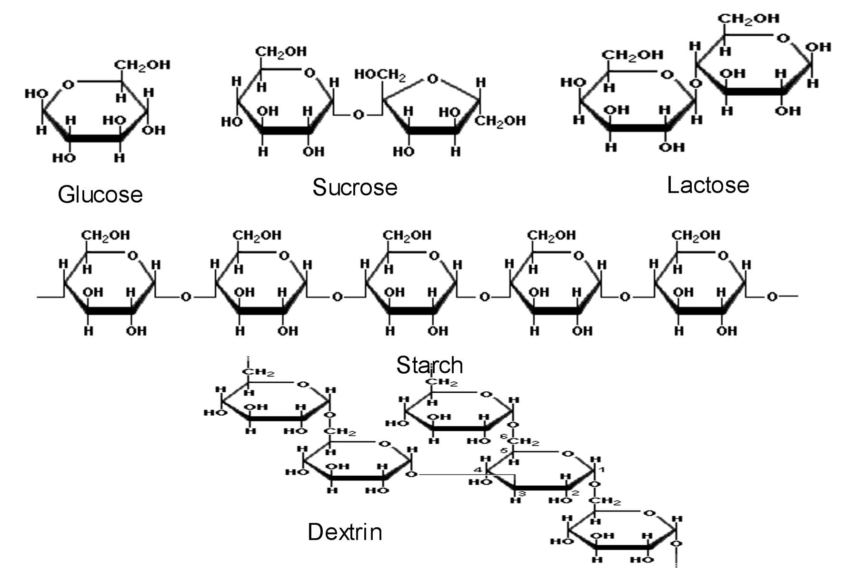
Carbohydrates
Their main purpose in animal cells is to be the fuel for metabolism
Human cell membranes are coated with proteins, while some of them fill the space between cells
Many carbohydrates are belived not to contribute dominantly to admittivity of the tissue
Fig. 6 Chemical composition of common carbohydrates

Slide 8
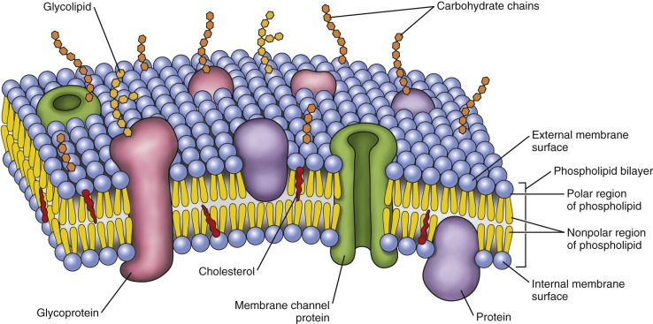
Lipids and bilayer lipid membrane
Lipids are water insoluable oily substances
Polar lipids are made up from hydrophilic and hyrdophobic parts, and often form micelles, monolayers and bilayers
Bilayer lipid membrane is a main contributor to capacitive nature of cells and tissues
This bilayer has a thickness of 7 nm and potential difference of 70 mV
Fig. 7 Schematic of bilayer lipid membrane
Notes:
The cell membrane is an absolute condition for life, because by it the cell can control its interior by controlling the membrane permeability. If the membrane is destroyed the cell dies. The membrane is a layer that separates two solutions, and forms two sharp boundaries toward them. The cell membrane consists of phosphol- ipids that form a bilayer lipid membrane (BLM) about 7 nm thick ( Fig. 4.6). Each monolayer has its hydrophobic surface oriented inward and its hydrophilic surface outward toward either the intra- or extracellular fl uids. The inside of such a bilayer is hydrophobic and lipophilic. A BLM is a very low electric conductivity membrane and is accordingly in itself closed for ions. It let lipids pass, but not water. However, water molecules can pass specialized membrane channels (cf. Chapter 5). The intrinsic
conductance is of the order of 10 /span>6 S/m, and a possible lipophilic ionic conductivity contribution can not be excluded. Even if the conductivity of the BLM itself is very low, the membrane is so thin that the capacitance is very high and the breakdown potential low. The electric field strength with 70 mV potential difference and thickness 7 nm is 10 kV/mm. This rep- resents a large dielectric strength, but not larger than, for example, Teflon. And as we shall see this is not the potential across the bilayer itself, but the potential of the bilayer /span> the potential difference of the two electric double layers formed on each surface of the membrane. A complex coating of special carbohydrates covers the external cell membrane surface, the glycocalyx, strongly modifying surface properties. Many of the glyco- calyx carbohydrates are normally negatively charged, so that living cells repel each other. During fever the blood sedimentation (mm/h) is increased because the elec- tric charge of the erythrocytes is diminished so that they lump together. According to Stokes law (eq. 2.6) fl ow friction is proportional to sphere radius a, while the weight is proportional to a3: the larger the sphere, the higher the sedimentation velocity (cf. also the electrokinetic effects described in Section 2.4.6)

Slide 9
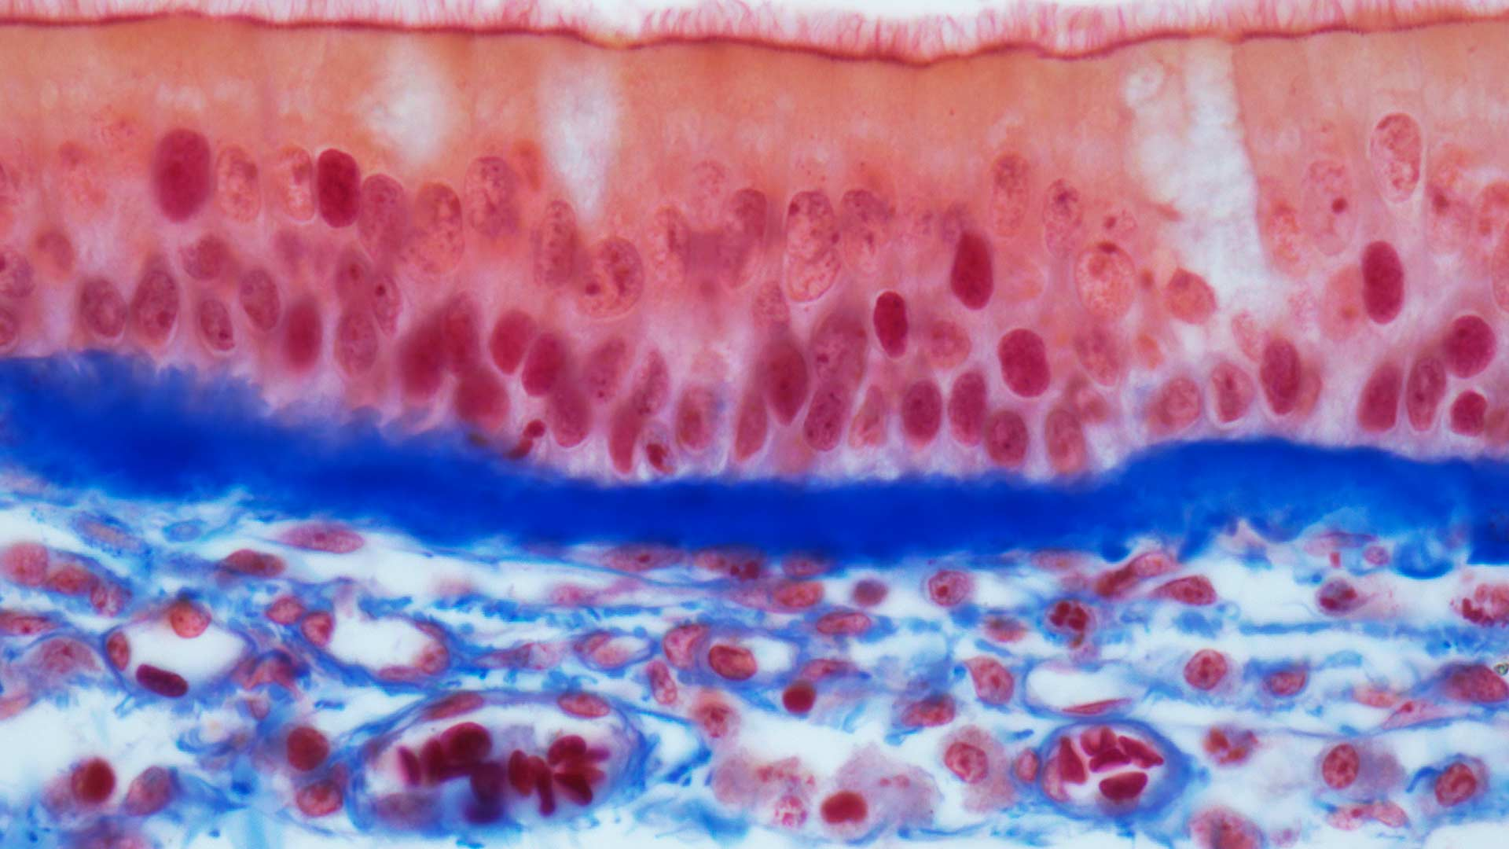
Tissues, organs and their reaction to electric fields

Slide 10
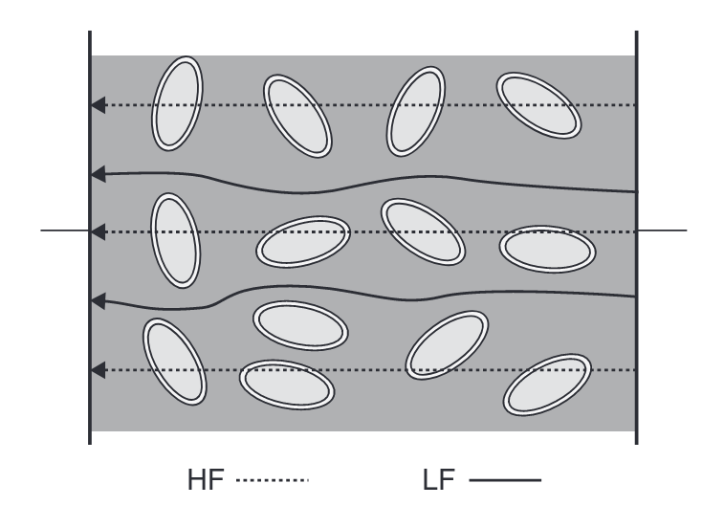
Tissue and its conductivity
Tissues are very heterogenous materials, which can be comprised from cells of different sizes and different functions
At DC and low frequencies cell membranes with high capacitance forces current to flow around cells through interstitial fluids
Ad high frequency AC current passes through cells, as its properties allow for it
Fig. 8 Low and high frequency current paths in tissue
Notes:
Tissue is a very heterogeneous material, and interfacial processes are very important. The cells are of uneven size and with very different functions. There is a large dif- ference between the tissue conductivity: from the liquid tissue fl owing through the blood vessels to the myelin sheaths as insulators surrounding the axons of the nerve cells, from connective tissue specialized to endure mechanical stress to bones and teeth, muscle masses, the dead parts of the skin, gas in lung tissue and so on. From an electrical point of view, it is impossible to regard tissue as a homogenous material. Let us consider a simple case with a volume of many cells in interstitial fl uids (Fig. 4.7). The cell membranes are considered to have a high capacitance and a low but complicated pattern of conductivity. At DC and low frequencies current passes around the cells. Lateral conductance in the double layers is also possible. Cell inte- rior does to a smaller degree contribute to current fl ow. At higher frequencies the membrane capacitance let AC current pass. The membrane effect disappears, and the current flows everywhere according to local ionic conductivity. All interfaces give rise to Maxwell–Wagner and counterion polarization effects as described in Section 3.5. In general tissue is an anisotropic medium because of the orientation of cells, macromembranes and organs ( Figs 4.30–4.32 ). Such an anisotropy is a low fre- quency phenomenon if it is due to membranes, but not if it is due to, for example,
air

Slide 11
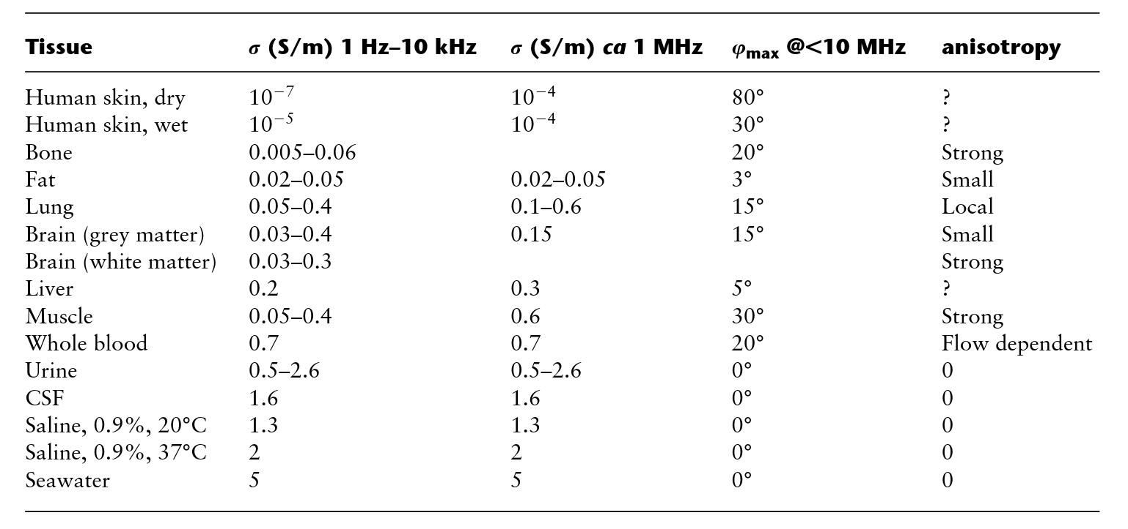
Tab 1. Typical tissue conductivity at low frequency and 1 MHz

Slide 12
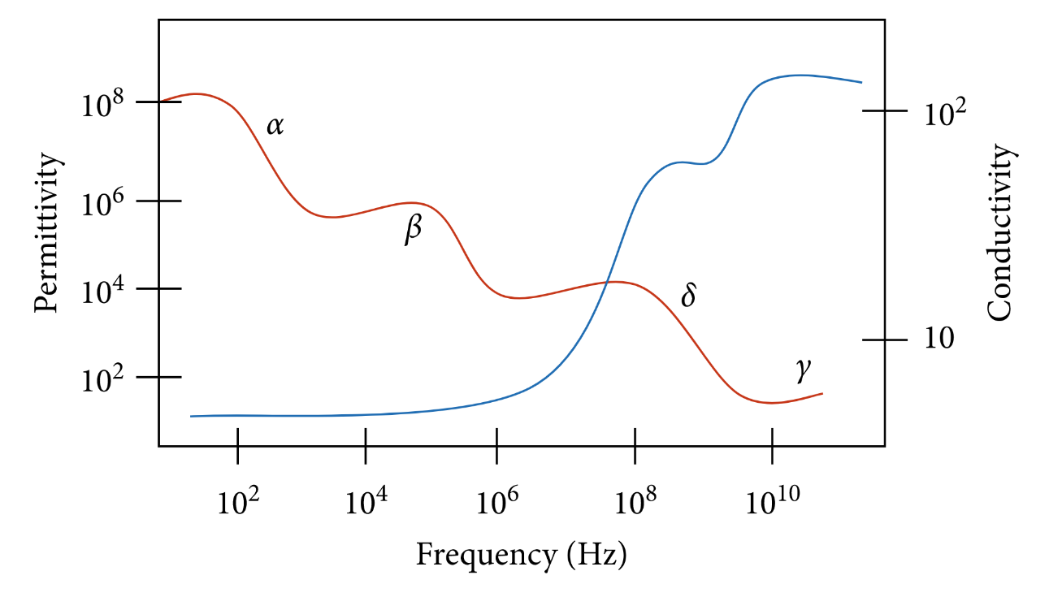
Alpha, beta, delta and gamma dispersions
Alpha dispersion occurs in low-frequency range 10Hz-10kHz and is associated with high permittivity increase
It comes from cell membrane and its high potential difference, where movement of charged particles is limited
Beta dispersion occurs in 10 kHz – 10 MHz, which comes from interaction at membrane-electrolyte surface
Fig. 8 Low and high frequency current paths in tissue
Notes:
The α dispersion occurs in a low-frequency range, i.e., 10 Hz to 10 kHz, while the relaxation time (τ) is 6 ms. This mode is categorized by a very high permittivity increment and very high dielectric decrement values (Δεα ≈ 106). This dispersion occurs near the cell membrane where the movements of charged particles are limited. The cell membrane is a complex structure consisting of phospholipids, cholesterol, proteins, and carbohydrates. There is a potential difference (approximately 60–70 mV) between the intracellular and extracellular media due to the ions which are distributed around the membrane (about 10 kV/mm).
he β-dispersion arises within the frequency of 10 kHz–10 MHz with a relaxation time approximately 300 ns. The cellular membranes and other intracellular bodies become charged (capacitive), leading to this dispersion type. The cell membranes are electrically shorted, while the current can penetrate through the cytoplasm. This penetration decreases the impedance and leads to the β-dispersion or interfacial polarization or the Maxwell–Wagner relation. This effect occurs at the interface of membrane-electrolyte structures, which have two different dielectrics, leading to the formation of charges. The polarization magnitude depends on the conductivity, permittivity, and structure of the distinct intracellular components.

Slide 13
Alpha, beta, delta and gamma dispersions
Delta dispersion is typical for frequencies of 0.1 to 5 GHz and its magnitude is small and comes from large molecules like proteins, biopolymers, cellular organelles
Gamma dispersion occurs at frequencies of above 0.1 GHZ and are typical to frequencies of around 25 GHz. Gamma dispersion depends on water and intercellular electrolytes
Fig. 8 Low and high frequency current paths in tissue
Notes:
Some protein solutions exhibit δ-dispersion, which lies between the β- and γ-dispersions. If present, the effect falls within the frequency of 0.1 to 5 GHz, and comparatively, its magnitude is small. δ-dispersion was first categorized in a study by Pethig [87] and was credited to the dipolar moments of proteins and other large molecules such as biopolymers, cellular organelles [88], and protein-bound water [89]. Mechanisms such as the relaxation of BW (dipolar) or molecules side chains and counterion diffusion in minor charged regions are possible origins of δ-dispersion.
In 1989, Foster and Schwan discovered γ-dispersion [90], which occurs due to the presence of water content in the cells and tissues. The dielectric properties of cells and tissues at frequencies above 0.1 GHz depend on the intracellular electrolytes and water (dipole polarization). At frequencies above a few hundred megahertz, the complex permittivity can be decoupled into terms of Cole-Cole and conductivity which are related to the dispersion of water (dipolar) and the electrolytic behavior,

Slide 14
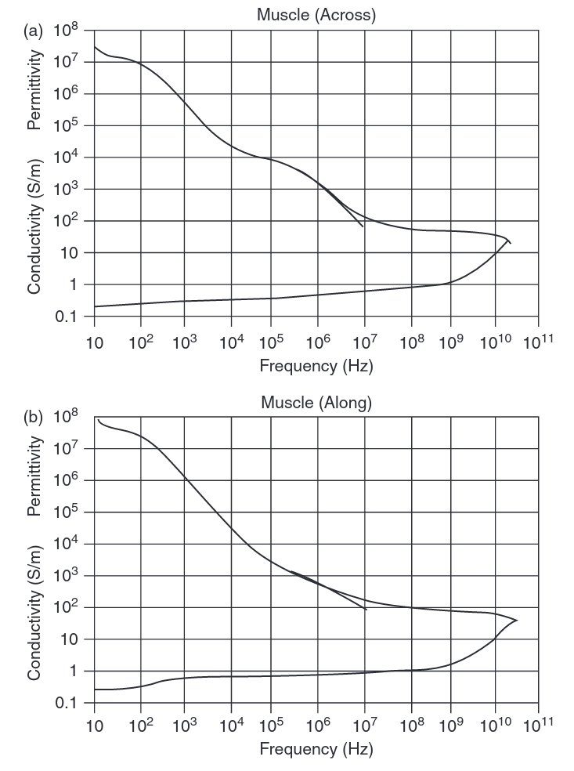
Muscles
Muscle tissue is highly anisotropic, which is connected to direct liquid paths in longitudinal orientation. This anisotropy has a ratio of around 1:8
These direct liquid paths show low frequency dependance
Longitudinal orientation measurements show alpha dispersion, while transversal are more dominated by beta dispersion
Fig. 9 Transverse and longitudinal values of permittivity and conductivity for different frequencies for muscles

Slide 15
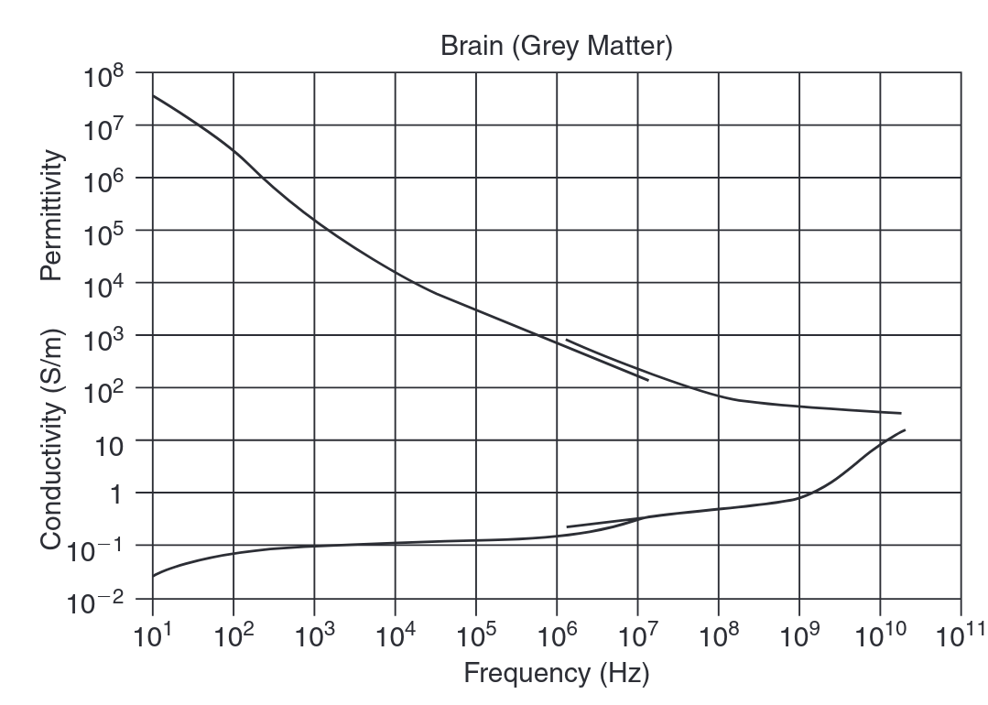
Nerve tissue
Brain is the only tissue with a large volume of nerve tissue
Nerves may be regarded as cables and thus electrical cable theory is often applied in measurements
An extra degree of complexity is introduced for myelinated nerves, as a myelin introduces high impedance
Fig. 10 Values of permittivity and conductivity for different frequencies for gray matter (brain)

Slide 16
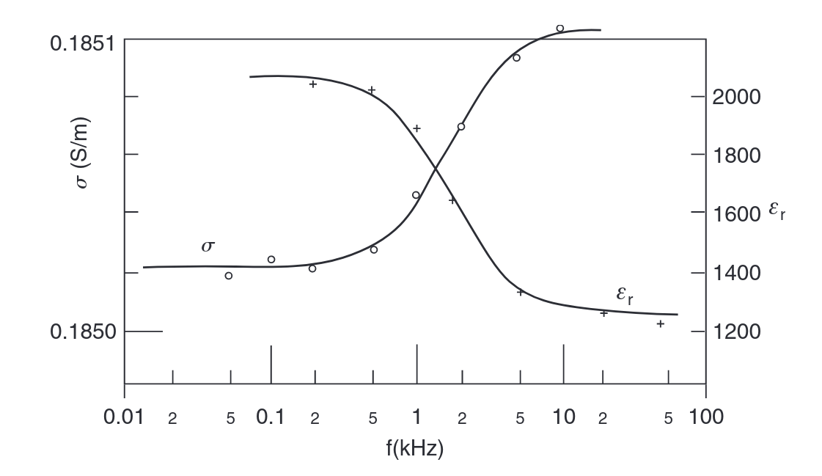
Blood and bone tissue
Blood consists mainly of plasma and erythrocytes (donut-shaped cells containing hemoglobin) and from electrical point of view it behaves as an electrolyte with dispersed large negatively charged molecules
Blood exhibits beta, delta and gamma dispersion, but curiously no alpha
Bone tissue exhibit a wide spread of permittivity and conductivity dependent on blood or other liquid perfusion
Fig. 11 Values of permittivity and conductivity for different frequencies for suspension of lysed erythrocytes
Notes:
Whole blood consists of erythrocytes (containing the hemoglobin) and other cells in plasma. Blood may be studied as whole blood in vivo, erythrocytes in suspen- sion, lysed erythrocytes in suspension, as plasma, etc. The erythrocytes are formed as doughnuts with an outer diameter of about 10 m. Plasma is the liquid part with electrolytes and large organic electrically charged molecules. Lysed erythrocytes are destroyed cells with their intracellular material (hemoglobin) emptied into the liq- uid. The electrical properties of whole blood and lysed blood are of course very different, Figs. 4.13 and 4.14. From Maxwell–Wagner theory it is possible to fi nd an expression for the conductivity of a suspension of membrane-covered spheres (Section 3.5.1). Whole blood exhibits -, - and -dispersion, but curiously enough no -dispersion, Foster and Schwan (1989). The -dispersion has a dielectric increment of about 2000 centered around 3 MHz (hematocrit 40%). Erythrocytes in suspen- sion have a frequency independent membrane capacitance with very low losses (Schwan, 1957).

Slide 17
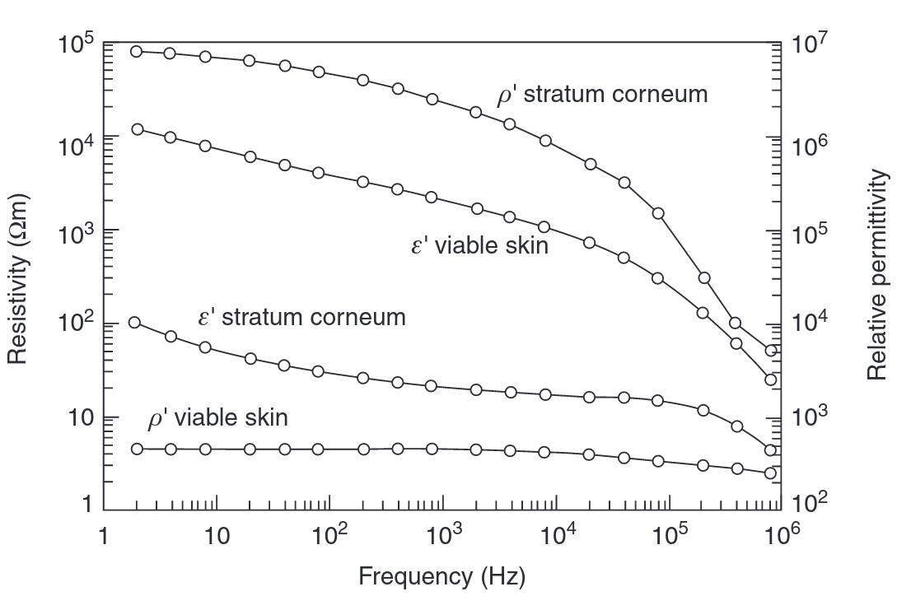
Skin tissue
Electrical properties of human skin are mostly dependent on stratum corneum which is outermost layer of skin made up of dead cells, especially in low frequencies
Stratum corneum, while insoluble in water it can absorb large quantities of it, forming thus a solid-state electrolyte. This property allows ions (f. ex. from sweat) to move and contributing to DC conductance
Fig. 12 Values of permittivity and conductivity for different frequencies for stratum corneum and viable skin
Notes:
Epithelia are cells organized as layers, skin is an example. Cells in epithelia form gap junctions . Particularly in tight membranes these junctions are special tight junctions. The transmembrane admittance is dependent both on the type of cell junctions and to what extent the epithelium is shunted by channels or specialized organs (e.g. sweat ducts in the skin). The impedance of the skin is dominated by the stratum corneum at low frequen- cies. It has generally been stated that skin impedance is determined mainly by the stratum corneum at frequencies below 10 kHz and by the viable skin at higher fre- quencies (Ackmann and Seitz, 1984). This will of course be dependent on factors like skin hydration, electrode size and geometry, etc. but may nevertheless serve as a rough guideline. A finite element simulation on a concentric two-electrode system used by Yamamoto et al. (1986) showed that the stratum corneum accounted for about 50% of the measured skin impedance at 10 kHz, but only about 10% at 100 kHz (Martinsen et al., 1999).
tratum corneum is not soluble in water, but the surface will be charged and a double layer will be formed in the water side of the interphase. Stratum corneum can absorb large amounts of water (e.g. doubling its weight). Stratum corneum may be considered as a solid state electrolyte, perhaps with few ions free to move and contribute to DC conductance. The stratum corneum con- tains such organic substances as proteins and lipids, which may be highly charged but bound, and therefore contributing only to AC admittance.

Slide 18
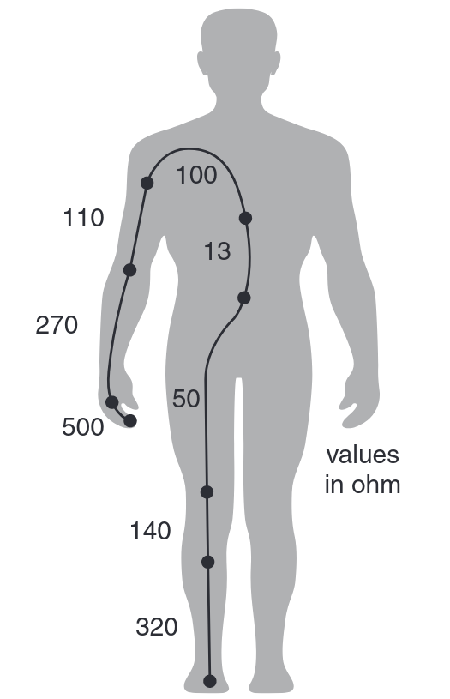
Whole body inductance
The value of impedance of whole body is usually dominated by contribution from skin
When not accounting for the skin, living body is considered purely resistive, and dependent mostly on mean resistivity, mean length and mean cross-sectional area of the body
On the fig. 13 please note importance of cross-sectional area as main contribution to resistance comes from finger and limbs, and close to none from torso
Fig. 13 Values of ohmic resistance of parts of human body

Slide 19
Bibliography
Grimnes, S. et al., "Bioimpedance and Bioelectricity Basics", second edition, 2008
Prasad, A. et al., "Bioimpedance analysis of vascular tissue and fluid flow in human and plant body: A review", Biosystems Engineering 197 (2020), pp. 170-187
Nasir, N. et al., "Cells Electrical Characterization: Dielectric Properties, Mixture, and Modeling Theories", Journal of Engineering, 2020
Grimnes, S. et al., "Alpha-dispersion in human tissue", J. Phys.: Conf. Ser. 224

